Slide 1
Virus Validate
Team 12 : Orange Team
By: Chetna Anjana, Matthew Prindle, Matou Sow, Camren Landry

Slide 2
Purpose of Virus Validate
To prevent the spread of illness in large crowds and everyday events
Ensure proper precautions are taken before entry to events

Slide 3
What is Virus Validate?
A platform for event hosts to allow there guests to submit vaccine cards and other precautions to ensure everyone's safety
Hosts can send an email to guests allowing them to submit credentials prior to the event

Slide 4
Target Users
Organizers of professional talks
With crowds, such as Ted Talks
Convention organizers
Meeting hosts with outside office clients

Slide 5
Tech Stack
HTML, CSS, JAVASCRIPT
React
Vite
React router
Front end
Python
API
Middle Layer
MySQL
Backend database

Slide 6
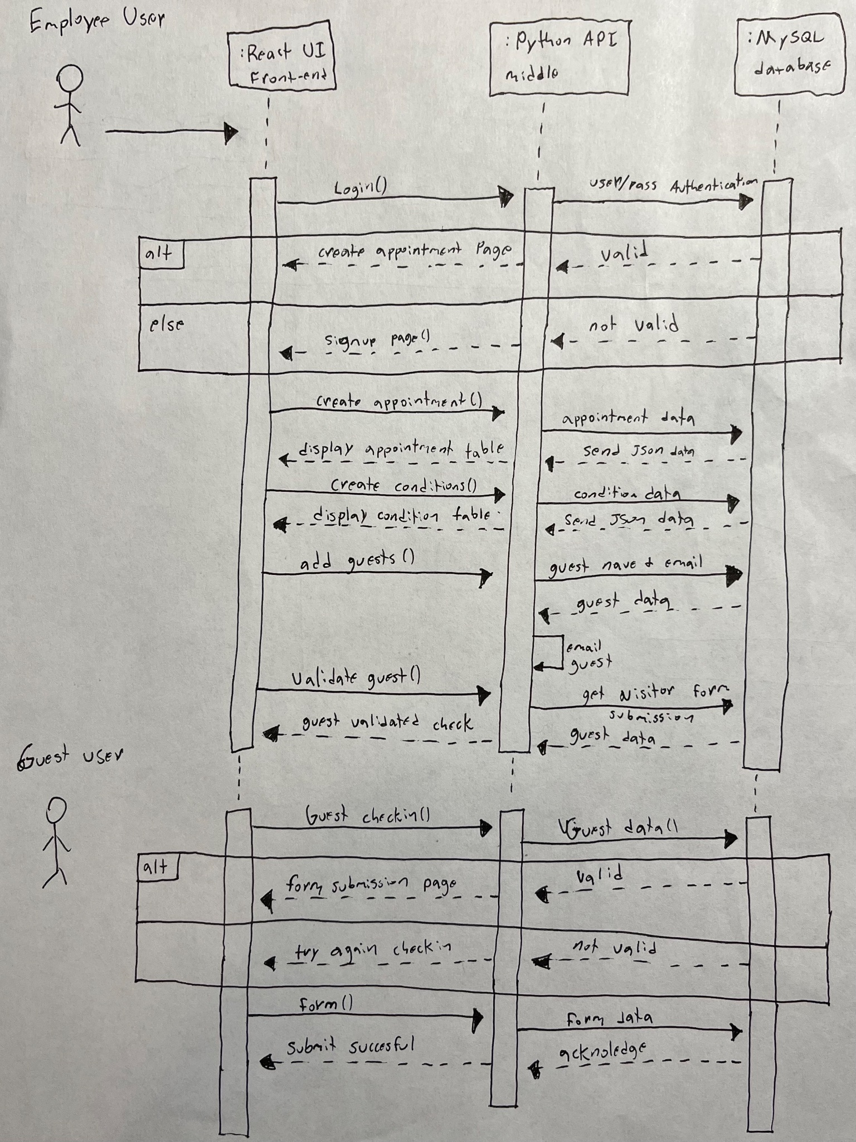
UML Sequence Diagram

Slide 7
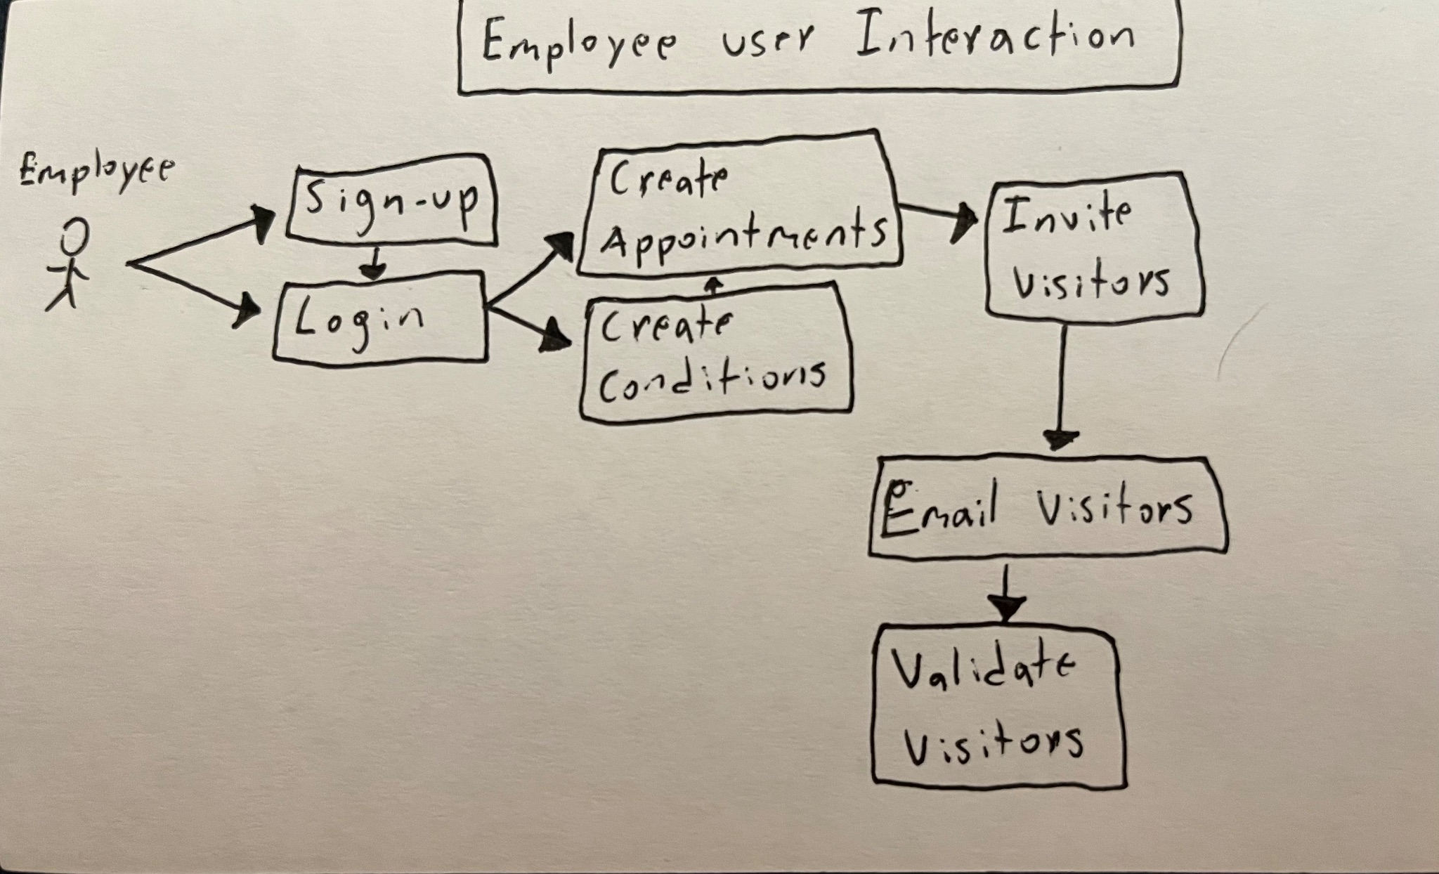
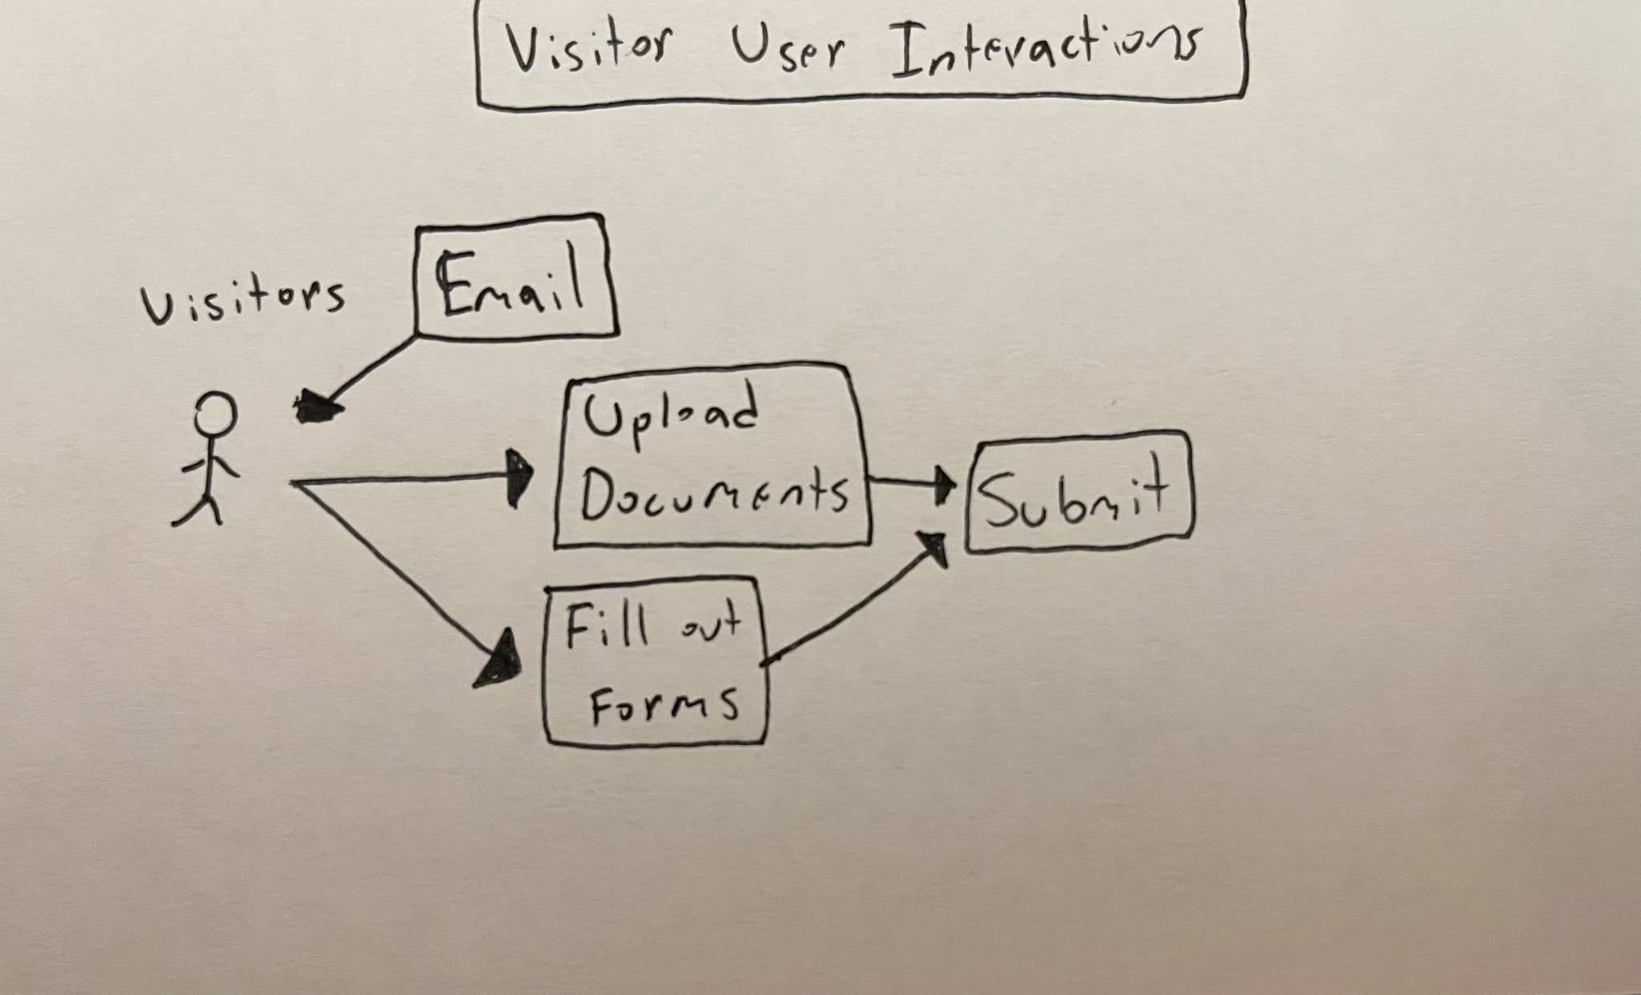
UML Use case Diagrams

Slide 8
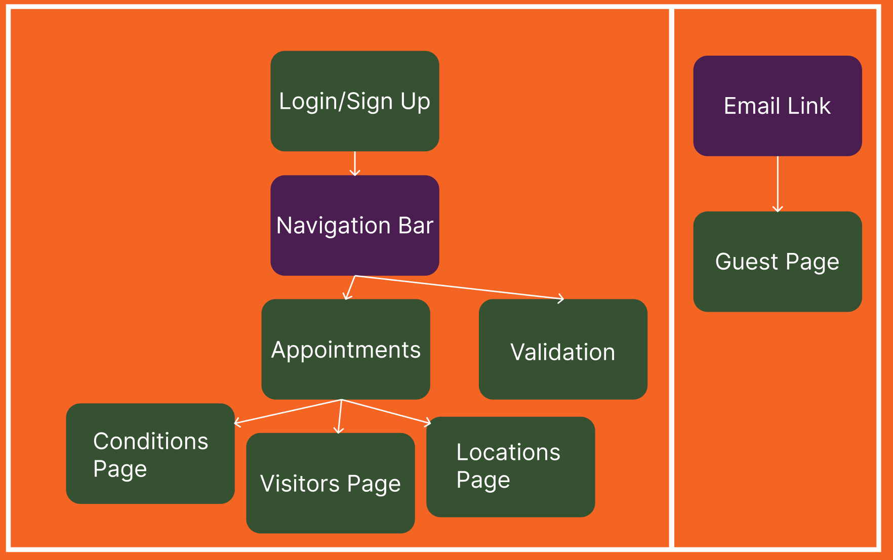

Slide 9
https://virusvalidate.crystalmesa.net

